Slide 1
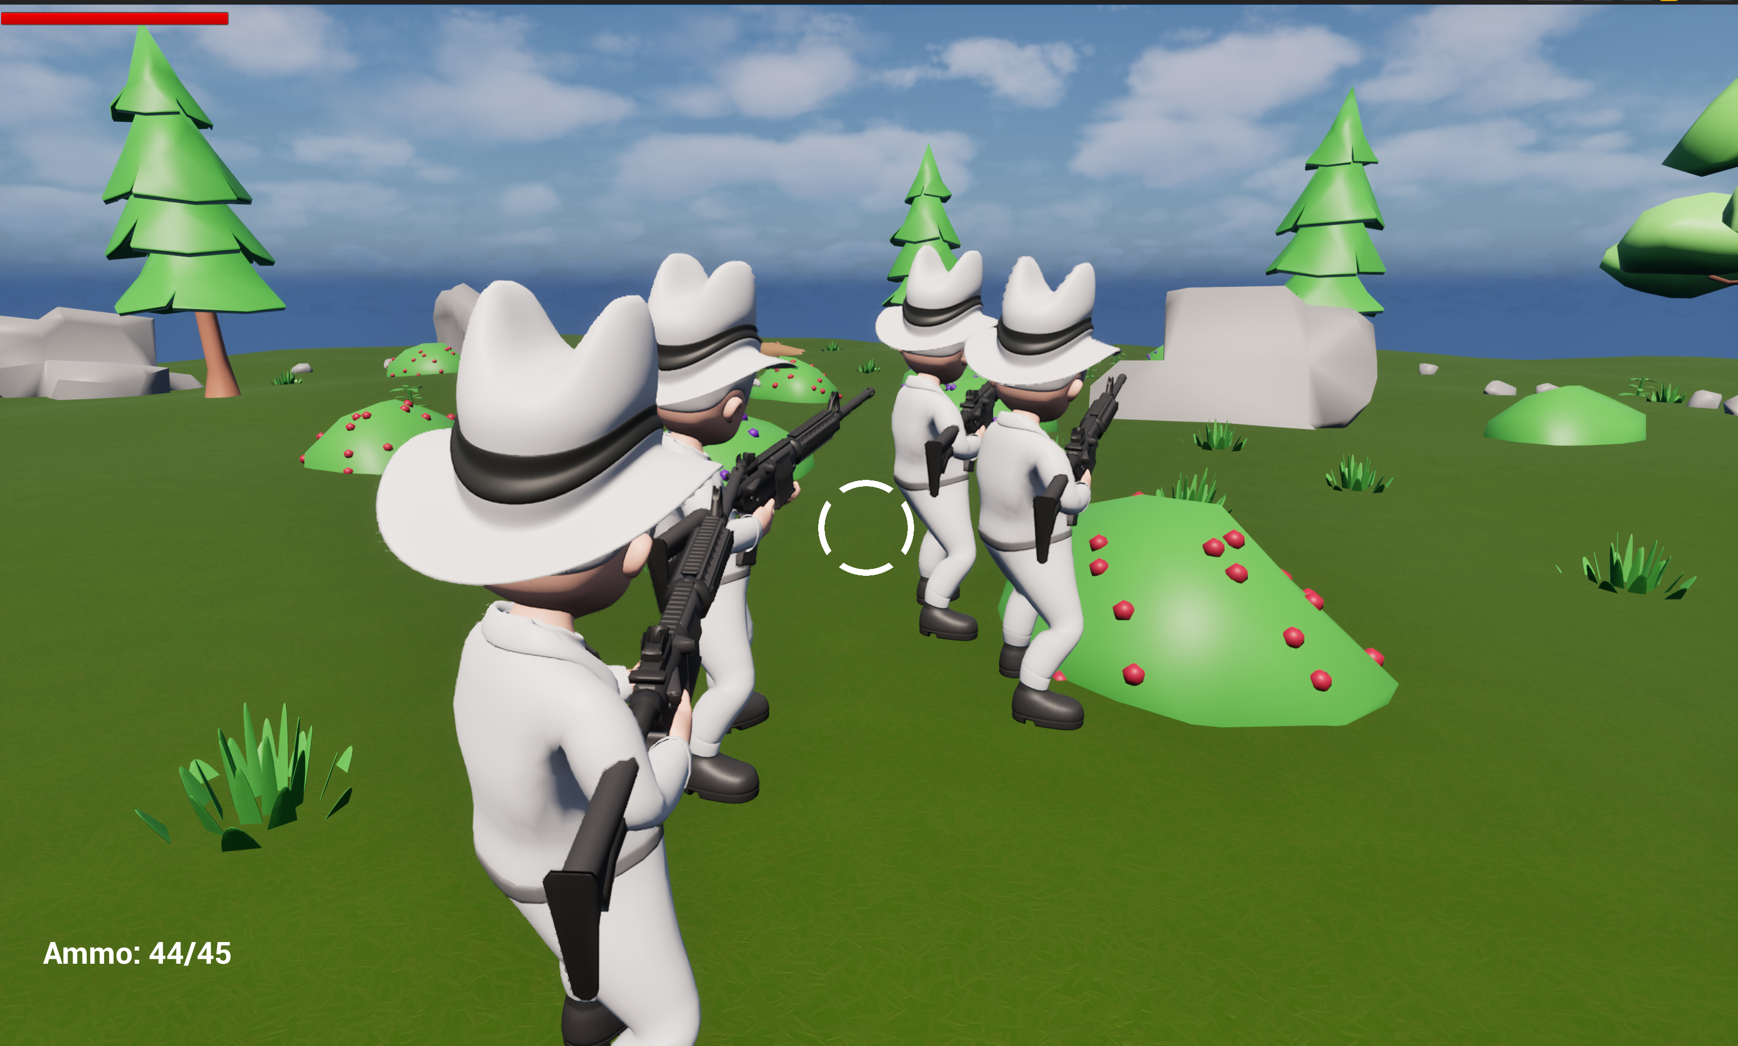

SHARED FATE vs INDIVIDUAL FORTUNE
Pacing, Payouts, and the Math of Eventual Symmetry
By: Sidd
Notes:
Hi everyone, and thanks for coming.
In multiplayer design, we usually ask ourselves: 'How do we make loot feel fair?' We worry about balance, we worry about stats, and we worry about power creep. But as I developed my 4-player co-op survival shooter, I realized that 'fairness' is actually just the surface level.
The real question we should be asking is: How does the structure of your loot pool dictate the physical tempo of your game?
In a roguelike, randomness generates content—but in multiplayer, it dictates pacing. Today, we’ll explore the tension between shared pools and individual progression. I’ll show how my 'Shared Deck' system eliminated the 'Pacing Wedge,' using data from 12 players to prove that Eventual Symmetry drives multiplayer retention.

Slide 2
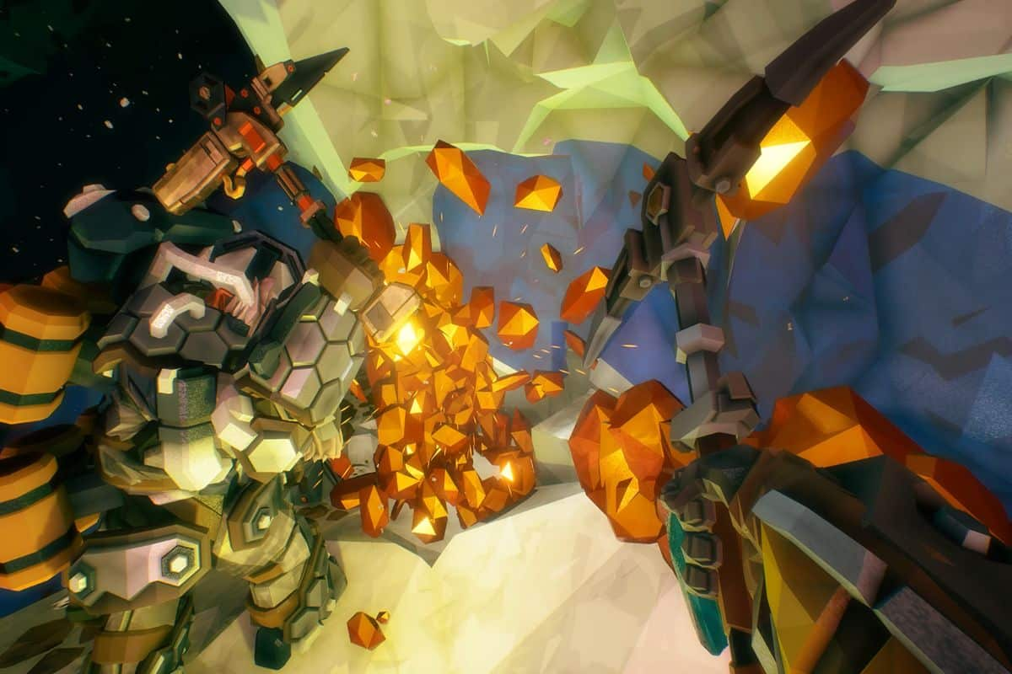
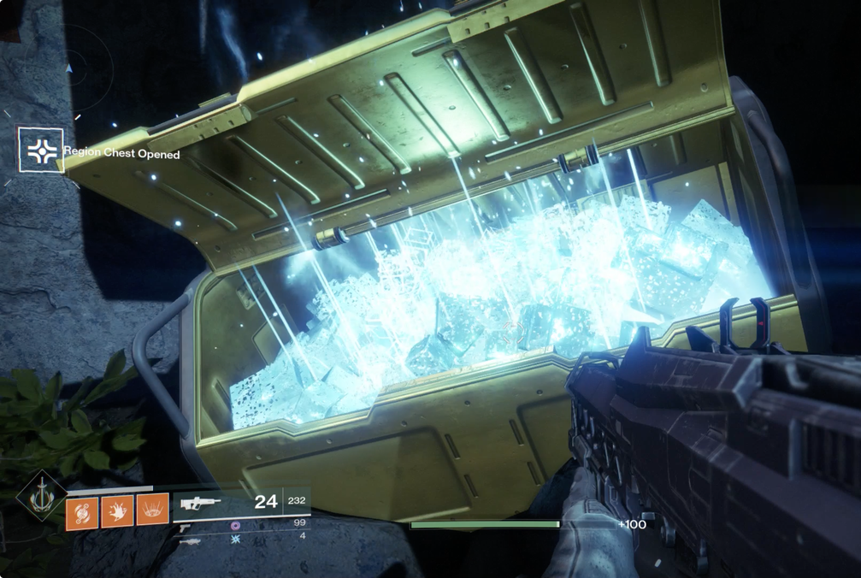
The Social Contract of Loot
The Shared Model
The Individual Model
Notes:
When we look at Slide 2, we’re seeing the fundamental architectural choice of multiplayer design. This isn’t just a UI decision; it’s a decision about the social contract of your game session.
On the left, we have the Shared Model. In a game like Deep Rock Galactic, loot is what we call a 'Social Object.' When a player interacts with a minerals and resources, the entire network state updates for everyone. The reward is simultaneous. From a design perspective, this creates Unified Pacing. Because everyone’s power level and progression are tethered, the team naturally moves as a single organism. There is no incentive to hoard or split off, because a gain for one is a gain for all. You are designing for a Squad, where the unit of success is the group’s total output. Other games that use this model are other coop games like Helldivers 2.
Now, look at the right: the Individual Model. This is the standard for games like Destiny 2. This model maximizes Player Autonomy. It’s built on the 'My Loot, My Build' philosophy. I don’t have to care what you found; I only care about my specific kit and my specific RNG luck. Other games that use this model are other looter shooters like Borderlands 4 and ARPGs like Diablo 4.
On paper, this is great for player agency. It allows for deep build diversity. But from a networking and social standpoint, this is where what I call 'The Rift' begins. As researcher Eetu Tirkkonen explores, the moment rewards become separate, player goals begin to diverge. The shared mission becomes secondary to the individual grind.
This 'Rift' is where players stop playing together and start playing near each other. When Player A finds an 'S-Tier' perk and Player B finds nothing, their motivations for the rest of the round shift. Player A wants to push into high-threat zones to test their power; Player B wants to stay back and scavenge to catch up.
By separating the loot, you are inadvertently introducing Systemic Friction. You are forcing your players to choose between the team's efficiency and their own progression. This slide represents the ultimate fork in the road: Do you want your players to feel like a unified Squad, or like four individuals who happen to be in the same room? This decision will dictate every networking, balancing, and pacing challenge you face for the rest of development.

Slide 3
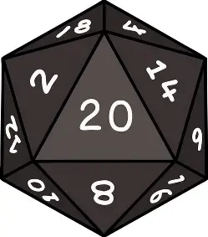
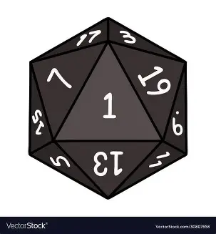

Randomness as a Pacing Wedge
$$P\left(p\right)=\frac{1}{N}$$
P - Any individual item that meets the eligibility criteria
N - The total number of items in current loot pool
Player 1
Player 2
Pacing Wedge
Lucky Player
Unlucky Player
Notes:
Now, let’s see how that 'Individual Fortune' choice manifests in actual gameplay—especially in a roguelike where randomness isn't just a feature; it’s the engine. In a single-player roguelike, RNG is a challenge to be overcome. If you get a bad draw, you adapt or you die.
But in multiplayer, randomness ceases to be a challenge and starts acting as a Pacing Wedge. Look at the diagram. When you have high-variance loot pools that aren't synced, you are driving a stake through the group’s cohesion. We start at the same line, but within two rounds, the 'Wedge' has physically split the team.
Here we see 'Pace Drag.' This is where the core loop of a 3rd-person shooter begins to tear. Take Player 1: They got lucky. They drew a 'God Tier' mobility perk and a massive AOE damage modifier. They are having a power fantasy; they are moving at 100 MPH.
But look at Player 2. They drew utility perks—a slight reload buff or a defensive stat. They are stuck at 20 MPH. In a single-player game, Player 2 is just having a 'bad run.' They hit reset. In multiplayer, there is no reset button. Player 2 is now a 'Pace Trap.' Because our maps are procedural, they are designed for a certain clearing speed. Player 1 is now forced to either sprint ahead and play solo, or stay back and 'carry' a teammate who feels useless.
This creates a massive Social Friction. We observed in our playtests that communication shifts when the Wedge is present. It stops being tactical—'Cover my flank'—and starts being logistical—'Where are you?' or 'Hurry up.' The 'God Tier' player is bored because the game is too slow; the 'Underpowered' player is frustrated because the game is too fast. As developers, we often balance for the average power of the group. But the data shows that players don't experience the average. They experience the Delta—the gap between the fastest and the slowest. And in a networked game, that gap is where fun goes to die.
We realized this wasn't just a 'feeling.' It was a statistical reality that was killing our round-retention. We needed a way to keep the individual 'Draw' feeling but kill the 'Wedge' permanently. This led us to the experiment.

Slide 4
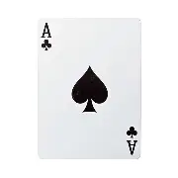
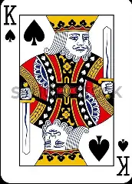
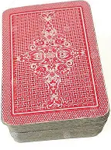
The Solution: Sequential Symmetry
Player 1
Player 2
Round 1
Round 5
Round 1
Round 5
Notes:
To solve the Pacing Wedge, I didn't want to get rid of the excitement of individual builds. I just wanted to tether their destination. This led to my project's core mechanic: The Global Deck.
In my 4-player survival shooter, we use a shared pool of perks. When the 'Draw' phase happens at the end of a round, each player pulls from the same deck. Here is the twist: Every player receives a different perk in the moment, but by the end of the session, the players will have drawn the exact same set of perks. We call this Sequential Symmetry.
To prove this worked, I ran an experiment. We tracked 12 players—split into 4 unique groups—across 12 rounds of survival on our procedural maps. We wanted to see if this 'eventual equality' could solve the social friction we saw earlier. I focused on two metrics: The Power Delta—the gap between the strongest and weakest player—and The Completion Velocity—how fast the team cleared the procedural map. We wanted to know: Does knowing you will catch up change how you play now?

Slide 5
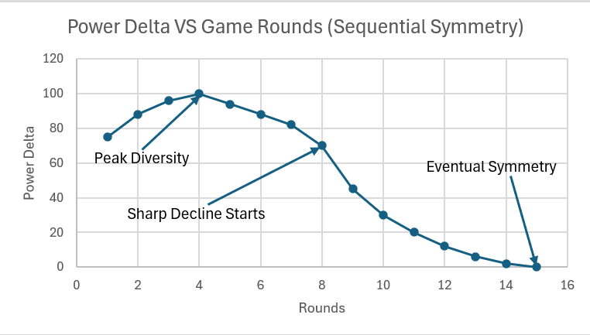
Data Findings: The Rubber-Band Effect
Notes:
The data revealed what I now call the 'Rubber-Band' effect on pacing
Look at the peak of the graph around Round 3. In the early game, my 'Shared Deck' actually creates a High Power Delta. Because Player 1 drew the 'Damage' perk while Player 2 drew 'Utility,' their roles are forced to be different. This is actually a good thing! It creates a 'Tactical Split' where players naturally fall into 'Vanguard' and 'Support' roles. Because they know this is temporary, they lean into these roles instead of resenting them.
The magic happens at Round 8. Because everyone is drawing from the same finite deck, the 'Power Delta' begins to collapse. By the time the players hit the final rounds, the gap in their efficiency is near zero.
Unlike games with purely infinite RNG, our groups didn't suffer from 'The 12-Round Wall.' Our Time-to-Completion (TTC) stabilized significantly. We found that late-game rounds were cleared 22% faster than in our random-drop builds. Why? Because the squad moves as a single, perfectly synchronized unit of destruction. The 'Pacing Wedge' isn't just managed; it’s systematically eliminated.

Slide 6
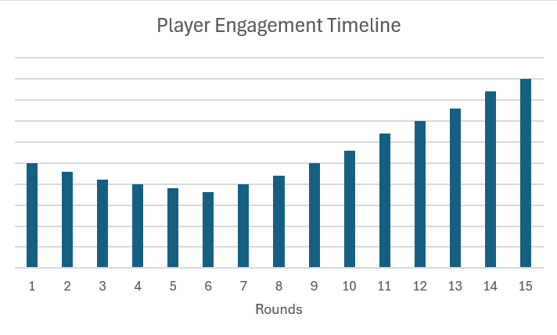
Correlation: Balance, Pacing, and Session Volume
Rounds 1 – 5 (Early Game, High Engagement): Role Discovery – Manage divergence, players embrace unique tactical identities
Rounds 6 – 10 (Mid Game, Sustained Engagement): The Push – The deck starts balancing, teamwork shifts to optimization
Rounds 11 – 15 (Late Game, Peak Engagement): Total Symmetry – The pacing wedge is eliminated, the squad reaches maximum synchronization
Key Findings: Players are willing to endure low luck early game if deck guarantees a symmetrical destination. Visible certainty drives commitment.
Notes:
So, I compared our players' behaviour against the industry baseline of 'Probable Catch-up.’
In most roguelikes, if you're the 'weak link,' you hope for a lucky drop to catch up. That hope is a gamble. In our study, we found that because catch-up was guaranteed by the deck, our 12 players completed an average of nearly 11 out of 12 rounds.
I didn't see the 'early-exit' phenomenon common in multiplayer shooters where one player feels left behind. Players are willing to endure being 'The Support' or the 'Low-Damage' teammate for a few rounds because the system provides a Visible Expiration Date on Bad Luck. We found that when the network guarantees eventual symmetry, players don't just play better—they play longer. We weren't just balancing stats; we were balancing player commitment.

Slide 7

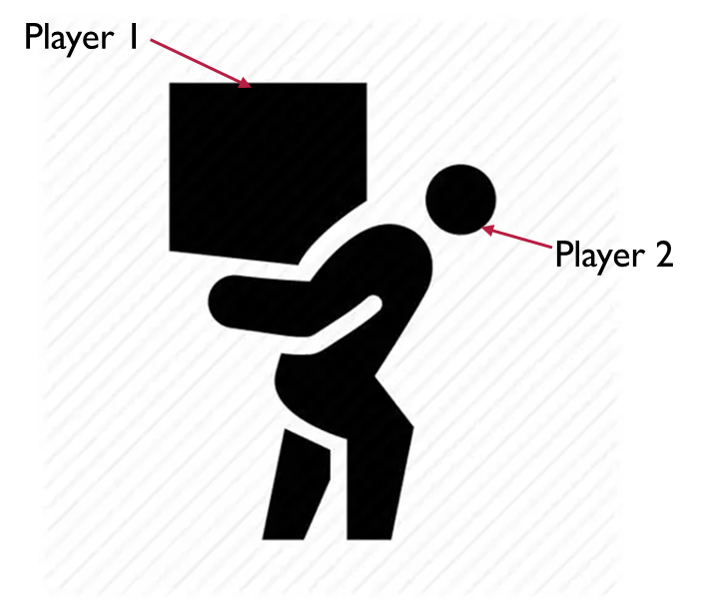
Relationship Within a Round: The Tactical Handover
Round 3
Round 11
Player 2
Player 1
Tactical Handover
Notes:
This 'Shared Deck' system fundamentally changed the relationship between our players within a single round. It created what I call the 'Tactical Handover.' In a standard RNG system, if I draw the 'God Build' early, I become the permanent 'Carry.' My teammates become my bodyguards. They stop playing the game and start watching me play it. But in our system, because we draw from the same deck, if I draw the 'Shield' in Round 2, I know I am the Vanguard for now. I take point. I clear the path.
But my teammates aren't frustrated by this, because they know—statistically—that by Round 5, that Shield is coming to them too. The 'Carry' dynamic shifts into a fluid rotation of roles. This synchronization is why our 12 players reported their highest satisfaction scores in the later rounds—they didn't feel like they were drifting apart; they felt the team was 'assembling' into a unified powerhouse. The social friction of the 'Wedge' was replaced by Anticipatory Coordination.

Slide 8
Conclusion: Design for Symmetry
Notes:
So, what is the ultimate takeaway for your next multiplayer project?
First: Balance IS Pacing. Don't look at loot stats in a vacuum. A power gap between your networked users is a 'Pace Trap' that will eventually break your procedural map flow.
Second: Prioritize Outcome over Order. You can give players the autonomy of individual builds and unique roles, but you must guarantee Endgame Parity. If the destination is the same, the journey can be as diverse as you want.
And finally: Manage the Hope. By using a 'Shared Deck' system, I gave my players a visible expiration date on bad luck. I turned 'Why am I so weak?' into 'I can't wait until it's my turn to be the Vanguard.’
Because at the end of the day, if your players aren't progressing at the same tempo, they aren't playing the same game. Let's build games where we win—and scale—together.
Thank you for listening.

Slide 9
Bibliography
Tirkkonen, E. (s.d.) 'Randomness in Roguelike Games’

